Slide 1
Customized Employment 2.0:
Principles to practice
May 8th, 2023
Sara Murphy
Melbourne, AU

Slide 2
What Is Customized Employment?
…an individualized approach to employment planning and job development — one person at a time--one employer at a time. It is about building new positions based on the needs of an employer and the strengths of the job seeker. It is an effective way to assist people with more significant disabilities to become contributing members of today’s workforce.
US Department of Labor,
Office of Disability and Employment Policy

Slide 3
Customized Employment Process
Person Centered Discovery Process
Exploration and Field Research
Evaluate Employer Needs & Fit
Present Solutions (negotiate)
Identify themes, employment settings
Target Employers
Informational Interviews
Job Placement
Network for Contacts
Notes:
A person-centered, business led process. Iterative process– requires business background and creative sensibility.

Slide 4

Customized Employment re-frames how we see job seekers with disabilities and how we approach and partner with employers..

Slide 5
Help Wanted
Company looking for individual with developmental disabilities, autism and/or history of aggressive behaviors. Extensive history of segregation preferred. Social challenges and anxiety, okay. Supportive co-workers.
Call for an application.
Notes:
Employment is not about what is aberrant
or broken, or what needs fixing-
It is about adding value
We need to see Disability as
“Human Variance”
We need to identify what a job seeker’s can do– the job seeker’s strengths and interests

Slide 6

Starts with Reframing How We See the People we Serve
Focus has been on Disabilities, what is wrong or broken
Instead of what is meaningful. What defines this person?
What are their passions, skills, strengths and life experiences
Strengths vs. Deficit list

Slide 7
Customized Employment
Not looking for jobs, it’s about creating opportunities

Slide 8
Reframing ROY
What his file said:
Attention deficit
Developmental disability
Bombed out of 3 work programs
Can’t sit still or focus
Late – constantly calling in sick
Bad attitude, aggressive, violent
Limited academics, can’t read or write, no computer skills,
What we said:
Active guy
Very outgoing
Likes to move
Loves variety
Can match numbers and use site words
Loves expensive cars
Notes:
HOW DID WE GET THERE?
Person-centered planning with a purpose
Focus on preferences and what a person can do
Shifts emphasis to adding value
Targets businesses where job seeker’s unique characteristics and skills will be assets
The Tornado
Roy working at a car wash where they do detailing for Pacific Heights residents – very high end cars. Chauffeurs would bring cars in. Roy works on the outside of the cars, but also gets to sit inside them while cleaning the inside.
When he interviewed, he hit it off right away with the owner – talking about luxury cars.
Divisidero Touchless Car Wash
So how do you come up with a job that hits the mark – motivates, right amount of activity, uses person’s strengths?

Slide 9
What’s a good job for Roy?
Use VENN diagrams to target employment settings based on candidate’s unique characteristics.
Fast-paced, lots of variety
No desk jobs. Loves to work with his hands
Loves cars- “Nice cars, not Fords”

Slide 10
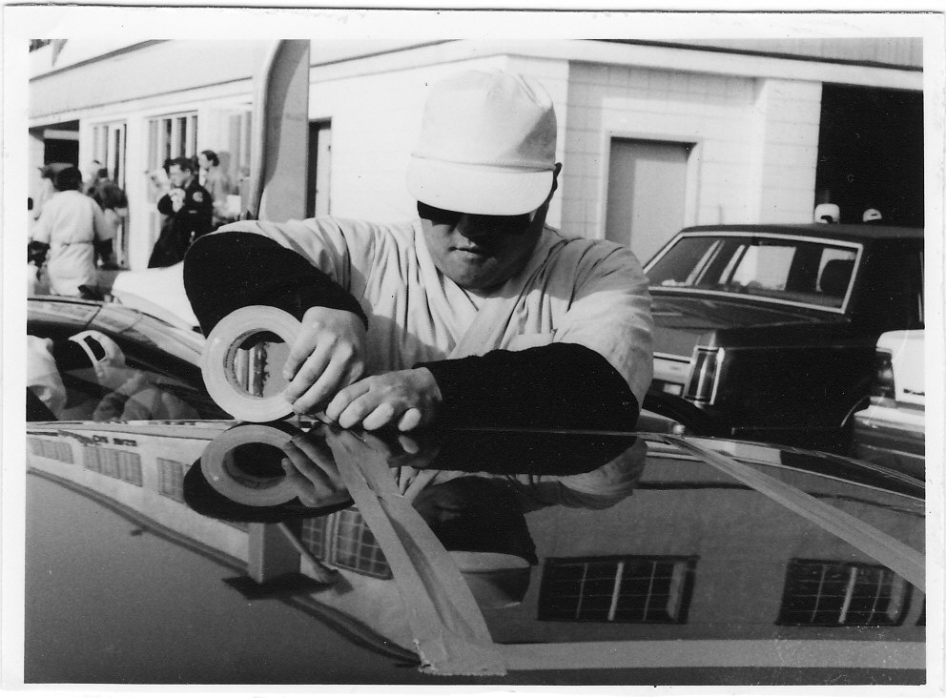
Employee of the Year
Divisadero Car Wash
Notes:
Can’t focus
Can’t work
Cleaning and hated it.
A number of jobs – ended disasterously. Hit someone.
Liked the paycheck – had some motivation but giving up
Lost interest - Because of his experience and getting into trouble – he was very hesitant
Need to find something that would get his interest and motivate him.

Slide 11
Why was Roy Successful?
Job matched not only his skills but also his interest & aspirations
Roy has skills (or attributes) the employer valued and a passion for the business
Job developer found an employment setting and job tasks that matched Roy’s skills and interests, and minimized his disabilities
Job developer was able to demonstrate how hiring Roy would add value to the business and address a workflow issue.

Slide 12
CE: A Skills, Not Deficits, Approach
Focuses on job seeker’s strengths and preferences
Presumes all job seekers are ready to work
Person-centered, discovery process is essential
Identifies what a job seeker likes to do- and can do
Profile is used to target businesses where job seeker’s unique characteristics and skills will be seen as assets
Shifts the conversation with employers away from “Disabilities” to “adding value”
Notes:
Customized employment should not be designated as the “new model” for job seekers with disabilities, but should expand the use universally accepted practice which recognizes the power of community and emphasizes relationships
Customized employment gives power back to individuals, families, employers and community stakeholders fosters flexibility, individuality, unique strengths and desires and a partnership with the natural community

Slide 13

How can we identify potential employment settings that are a good fit for the
job seeker?

Slide 14
Discovery
The question is not IF a person can work, but WHERE.

Slide 15
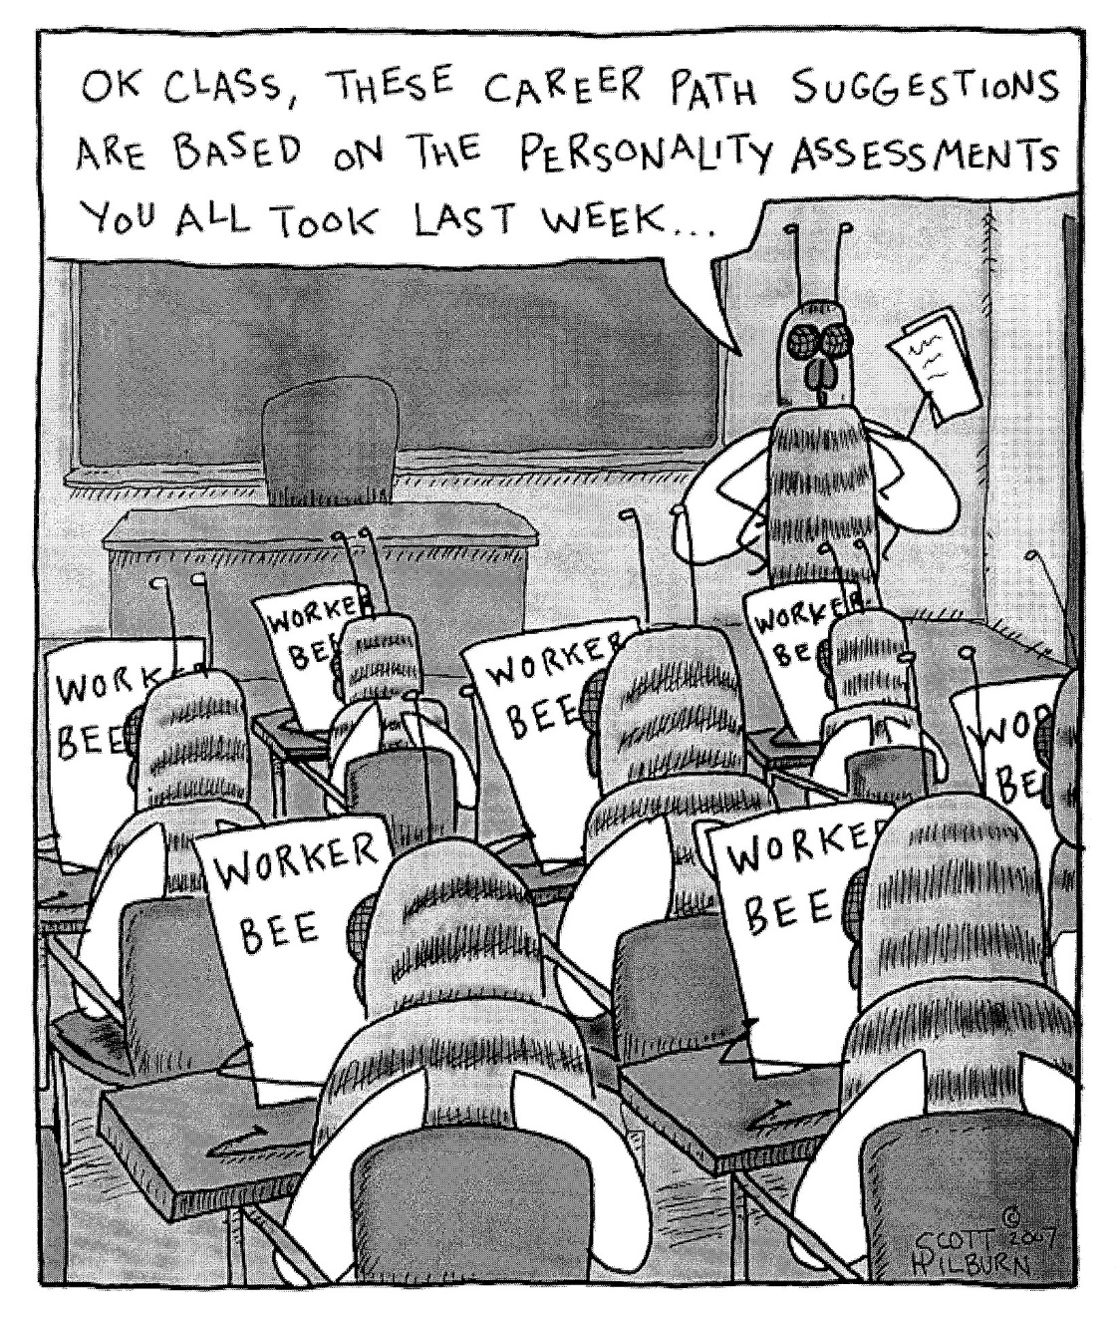
Our typical Assessment Tools

Slide 16
Exposure
Interest
Motivation
Employment
Notes:
If I take this a bit further:
Exposure precedes interest.
Interest fuels motivation.
Motivation leads to action.
So when someone tells me a youth or career seeker is “unmotivated” I challenge them to go back and find out what things capture the individual’s attention. What are their interests and passions? What activities do they gravitate towards? And if they don’t have any identifiable interests – I know we have to go back to exploration!

Slide 17
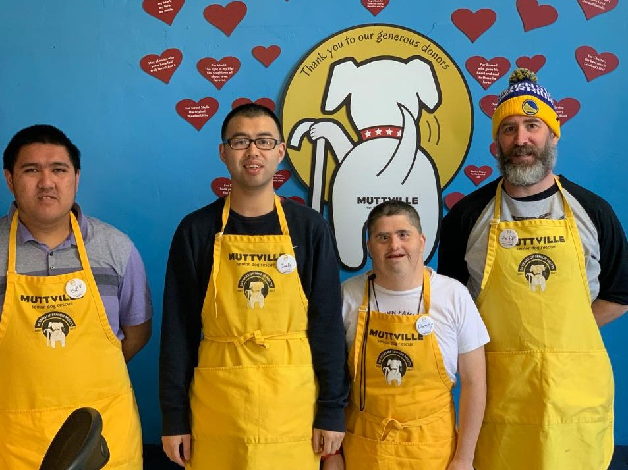
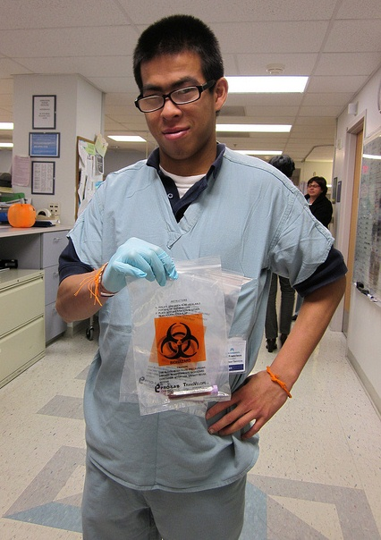


Volunteering and Internships
“This is not just about bagging rice”
It’s about learning employability skills and “giving back”

Slide 18

Customized Employment
Starts with a discovery process
and building a profile
We need to learn to listen to our job seekers- not lead.
Sue Austin, Artist and Scuba Diver

Slide 19
Interviewing and Active Listening
Review person’s file – but verify what you read
Meet at the person’s home or someplace neutral
Get the person talking
  Ask Open-ended questions: “Tell me about yourself” “What do you do for fun?”, “What do plan to do after school?”
  Repeat back or rephrase what the person says
  Be quiet- Silence is golden, and really uncomfortable
Conversations vs. Interrogations
Take notes and ask for clarification

Slide 20


Where can we learn the most about a person?
Where are we most relaxed? Where are we at our best?
Notes:
How would you start a conversation with a job seeker in the workshop?
What do you see in this job seeker’s room that you could use to start a conversation? Use open questions.

Slide 21

Talk with Family and Friends
Take a walk with the person – Where do you go? Who are your friends? What do you like to do?
What do you do at home? Chores? Fun?
Identify potential sites/activities for “doing something together”
Identify additional people to interview
Any ideas for local employment?
Look at accessibility/transportation options

Slide 22
Back to the bedroom…How would you start a conversation with this young man?

Slide 23
Building a Profile
Looking for Nuggets of Gold
Where will this Job Seeker SPARKLE?
Notes:
Believe in your job seeker, SKILLS, not deficits
No prerequisites
Everyone is “job ready”. Work with currentskills
Look for “rays of light” or unique skills
Look for employment settings that will value the job seeker’s assets and minimize disability

Slide 24
Positive Personal Profile
Starting point for determining skills and interests and what motivates a person
Simple one-page form
An encouraging, empowering document. Focused on strengths, values and interests.
Reframes how we see the people we support and how they see themselves
A starting point for Job Development

Slide 25
Positive Personal Profile
What are my skills and interests?
What is meaningful to me?
What are my dreams and goals?
What are my life experiences?
What do I value most in my life? What guides my actions?
Any unique talents?
What is your profile? What is meaningful for you?

Slide 26
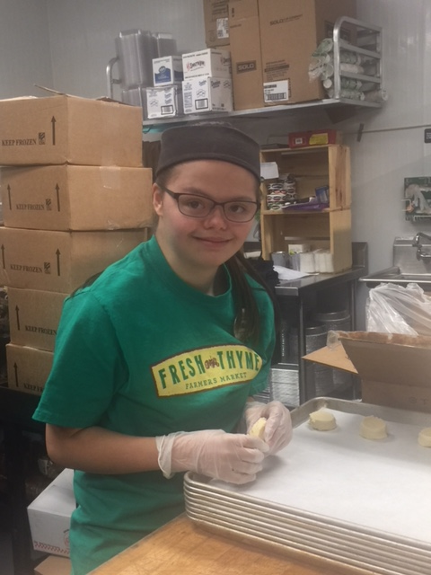
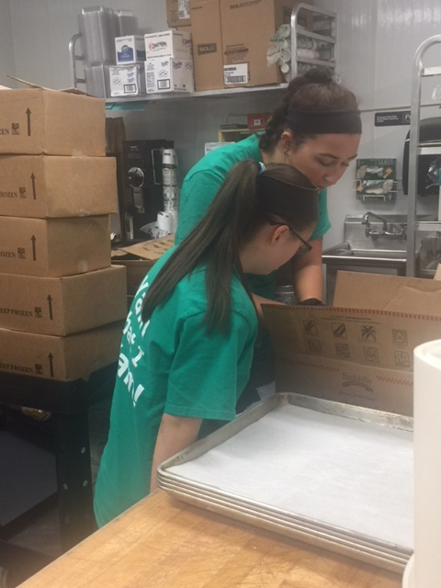

Maddie’s
Job Shadow, no wait- Job.
Notes:
discovery activity included canvassing the neighborhood
Asked where she’d like to go - immediately she replied, “Fresh Thyme” and explained that her mom often shops there, but has never been able to go herself.
instantly noticed the bakery department; was in awe with all of the different baked goods.
he Employment Consultant and Maddie looked around for an employee who would be able to answer questions about the store and bakery department and met Katie, the bakery manager. Informational interview asked Katie what the requirements were to work in the bakery department, how long she had been working there, what Katie liked about her job, and what the most challenging part of the job was.
During the discussion, Maddie kept her focus on Katie while she spoke and began conducting an informational interview of her own asking questions about production and what the most popular item was and then asked Katie how many employees they currently had. Katie replied, “We currently have four employees” to which Sarah replied, "I think you guys should add a fifth, and it should be me."

Slide 27

5-minute Activity
Test drive the PPP and profile yourself
Share your answers with people at your table
What was this like for you? Was it easy or hard to fill it out?
27
Notes:
27
Shows the flow of developing a JD plan rather than just shooting from the hip
It is important to have a plan in order to customize your JD activities while you are meeting the needs of business

Slide 28
Targeting Potential Employment Opportunities
Using Venn Diagrams to “get out of our boxes”

Slide 29
Customized Employment Process
Person Centered Discovery Process
Exploration and Field Research
Evaluate Employer Needs & Fit
Present Solutions (negotiate)
Identify themes, employment settings
Target Employers
Informational Interviews
Job Placement
Network for Contacts
Notes:
A person-centered, business led process. Iterative process– requires business background and creative sensibility.

Slide 30
Call a Meeting…
Bring the team together. The bigger the group, the better. Family, friends, neighbors, staff.
Lots of different, perspectives and experiences in the room
Prep the job seeker so they are ready to facilitate, advocate and actively participate
Make it fun, make it visual
  Venn Diagrams
  Graphic language
  Computer with internet access to search ideas in real time
Notes:
Once a preliminary positive personal profile (PPP) is completed, The PPP can be shared at a meeting with the job seeker, family, friends or anyone who has an interest in the job seekers job search. These meetings provide key discovery and assessment information based on person’s who know the job seeker best. These meetings can also generate employer leads that can generate assessment and placement opportunities.

Slide 31
Venn Diagrams
Use Venn diagrams to help target employment settings
Ideal Setting
Interests
or Passions
Talents and skills

Slide 32
Reframing Mattie
What Mattie's file said:
Developmentally disabled
Deaf and blind
Lived in an institution most of her life
“Failed” at several work placements
Nonverbal
“Behavior outbursts”
Moves slowly
What we Discovered:
Very curious
Loves variety and learning new things (like tactile communication)
Likes working with her hands
Always smiling
Enjoys cooking (smelling the food, stirring, laughs)
Loves swimming (especially the whirlpool)

Slide 33
Mattie’s Venn Diagram
What might a good job for Mattie be?
Working with her hands
Likes cooking
Desk Job

Slide 34
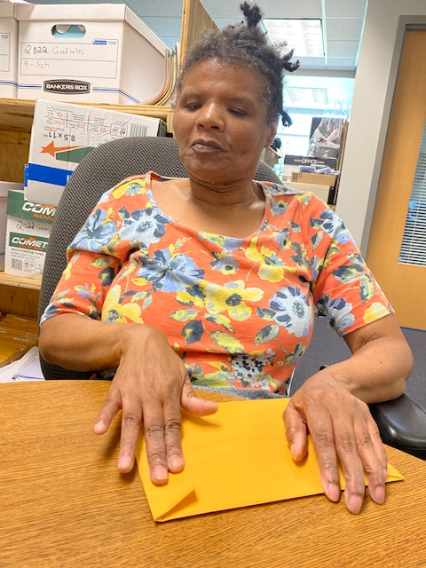

Mattie’s Jobs
10 years at
Menomonee Falls
School District
18 years at Pizza Hut

Slide 35
Employer Engagement
Reframing how we approach and partner with business

Slide 36
The Old Way to Job Develop
Looking for easiest jobs to find (high turnover, low pay)
Selling “disability” (i.e., “Hire the Handicapped”, “Untapped labor pool”, “give’em a chance” )
Emphasizing quotas, tax credits or other stipends
Cold calling, carpet bombing and job stuffing
Focusing on just the job seeker, not the business
“Job carving”

Slide 37

What Employers say about Hiring People with Disabilities:
“As much as we want to be compassionate, we have to meet the bottom line. All employees must contribute to the bottom line. Our question is, what can your candidate do to help our bottom line?
Alison Mitchell, VP
Appletree Credit Union

Slide 38

With Customized Employment,
We Must Switch Hats
We must stop selling “disability” and start selling “customized business solutions”
Social Worker
Employment Consultant

Slide 39
Check your message
Lion’s Blind Center, Goodwill, Catholic Charities.
What are you selling?

Slide 40
No more “Selling Disability”
“Untapped labor pool”, “Hire the Disabled”, “Give him a go.” (Deficit Marketing)
Focus is on Job seeker’s skills , not tax credits or employer stipends
Customized Employment is not “job carving”. It is building jobs based on the employer’s needs and a job seeker’s strengths.
We must stop stigmatizing our candidates!

Slide 41
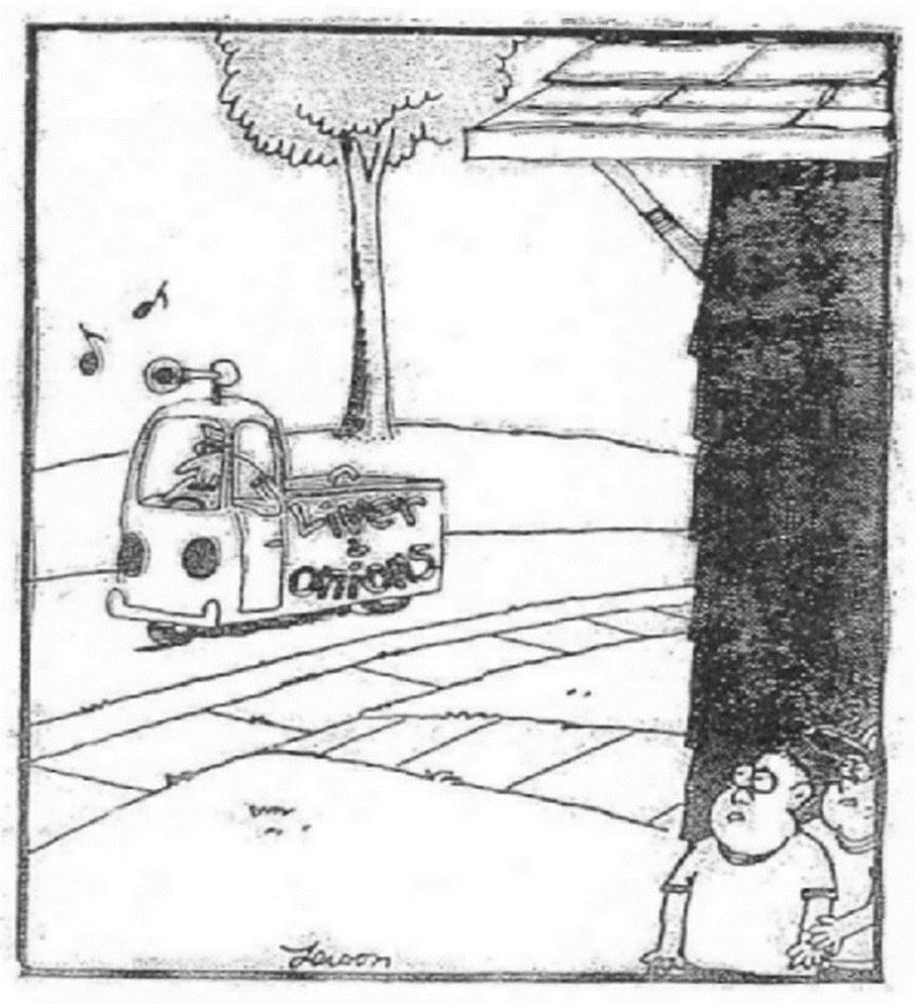
Marketing vs. Selling
“It is better to find out what your customers need and want and then match it to what you have, than it is to get them to buy what you are selling.”

Slide 42
What’s Your
Elevator Speech?
What do you say
when someone asks, “what do you do?”
Notes:
Assign Homework.

Slide 43
Effective Elevator Speeches
Are Short. An elevator speech is NOT a sales pitch. Think 3 to 4 sentences!
Use Everyday Language. Avoid our jargon or sounding like a salesman
Start a Conversation. Ask a question of your listener. A successful elevator speech is when the other person says “Interesting. Tell me more.”
Notes:
Make it Brief – getting message across to a stranger in the time it takes to ride an elevator a few floors
Remember to create positive image
Convey competence/quality, not human service or charity
EXCHANGE BUSINESS CARDS!
An employer's business card is like gold!

Slide 44
Use Positive Language and Business Terminology
Look at your agency’s branding & website
No social service lingo or acronyms
“Candidates” vs. “clients/consumers”
“Systematic , routine tasks”, “entry level” vs. “easy, menial jobs” or “repetitive work”
“Recruit and screen candidates” vs. “job development”
Business tools and principles (i.e. Lean, Six Sigma)
“Orientation and training” vs. job coaching
Tools vs. accommodations

Slide 45
Advantages & Benefits for Employers
Cost effective way to improve workflow and reduce waste
Supports core staff so they can concentrate on key aspects of their positions
Productive, dependable, loyal employees
Reduces recruitment and training costs for support positions
Diversifies the workforce
Leverages resources of employment service to assist with orientation and training of the new employee.

Slide 46
Activity
Write Your
Elevator Speech

Slide 47
Networking
Learning about business needs and
building relationships with employers

Slide 48
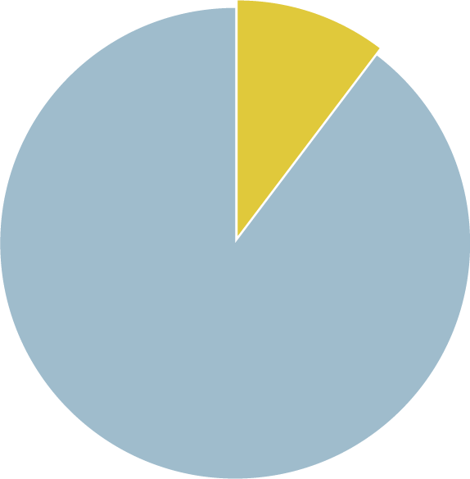
Why is networking so important?
80% of job seekers only apply for posted positions.
But, only 20% of
jobs are ever posted.
20%
Network
20% posted
80% of jobs of Jobseekers apply for jobs via postings
80% of jobs are NOT posted
Notes:
Businesses Have Needs, Get Them Before a Position Has Been Posted

Slide 49

Everyone is a Job Developer!
Everyone in your agency – set up a white board
  Board of directors
  Administrators
  Others…
Personal and professional networks
  Job seekers, family, friends, neighbors
Notes:
Go to your cell phone – look at all the people you know – what professions, associations?
Most of us have a sphere of influence of about 250 people – and the important thing is so does everyone else in this room!

Slide 50

Personal Sphere of Influence
You Already Know All the People You Need to Know!
Immediate family – distant relatives
Close friends – casual acquaintances
People you do business with – mail carrier, plumber, tailor, barber, dry cleaner, deli counter clerk, gas station attendant, etc.
People who do business with you – family members, other businesses, school personnel, etc.
Notes:
Girard’s Law of 250 (Joe Girard, How to sell anything to anybody)
The people you know – people who are directly or indirectly part of your life

Slide 51
Activity
Write down your “ideal” job - if you weren’t doing this job!
Go around the table – introduce yourself – and identify your “ideal” job
Choose one person from your table who will be the job seeker (based on ideal job they identified)
Now…think of who you know, look at YOUR contacts on your phone, on Facebook, Instagram or LinkedIn. How many people do you know who know about this kind of job or industry?
Notes:
Normally I’d have you go through the yellow and white pages
Most of us have a sphere of influence of about 250 people – and the important thing is so does everyone else in this room!
51

Slide 52
Employer Relationships
Jobs
Prospects
Contacts

Slide 53

Where to Find Contacts
The Internet (e.g., Linked-In, Google, Facebook)
Business section of newspaper or business publications
Chamber of Commerce and other professional organizations
In your neighborhood/building
Carpools, elevators & dinner parties,…

Slide 54
Getting from “Contact” to “Job”
Know how a business works and more importantly, how it doesn’t
Build a relationship with the employer
Learn how the business works and the employer’s needs and challenges. Can your job seeker help address these needs? (“Prospect”)
“It’s the perfect place!” Present your ideas, solutions and candidate (“Negotiate Jobs”)

Slide 55
Informational Interviews
Talk to employers to learn about their businesses

Slide 56
Employees Must Add Value to an Employer’s Workforce
  .
Hiring is a business decision, not a social issue or charitable cause
Employment is a mutually beneficial relationship - must be right for both parties
There is a job out there for everybody- but it is about adding value – not charity!
Notes:
It costs $7 to $10K to training a new hire : In these instances, the right to work is earned. Employers have to hire the right person for the job. Mistakes are costly. Job seekers must demonstrate desired competencies and skills.

Slide 57
How Do You Get in the Door
Find a “warm”, not “cold” contact
Do not lead with “I work with people with disabilities”
A good opening line…
  “I work with job seekers interested in your industry. My Friend, Mary Smith, said you are an expert in the field and might be able to help me.”
Elevator Speech for your organization.
  “Who are you with? What does your organization do from the perspective of an employer?” (Do NOT sell disability)
Make your initial request easy…
  “Can I come see what you do and talk to you about the skills sets needed to work in this field.”

Slide 58

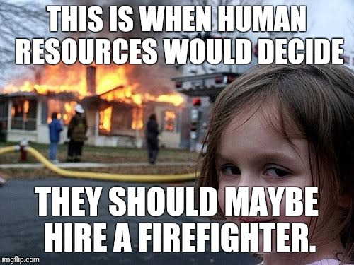
The “Right Person” May Not be Human Resources
HR is responsible for the bigger picture (strategy, projections, policies) and recruiting, on-boarding & managing staff
HR’s role is not necessarily understanding the nuances of the work being done.
HR is often the last to know that there are staffing needs in a department
Customizing Jobs is about Process Improvement
We need to talk to the people doing the work.

Slide 59
Informational Interviews:
The Focus is on the Business/Industry
The conversation is NOT about “the job seeker”
Gain an understanding of the workflow processes, “set-up/button-up” roles, essential skills and workplace culture
Opportunity to check your “pre-conceptions”
Build a rapport, establish a sense of trust with the employer
Identify challenges and inefficiencies

Slide 60
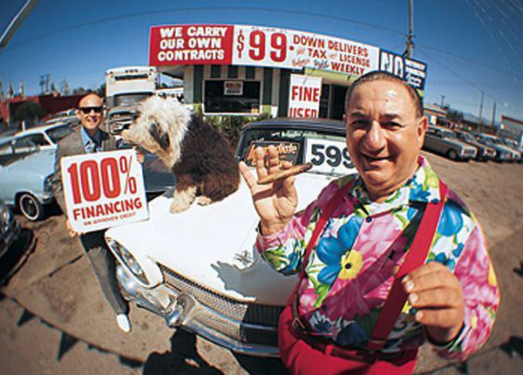
Marketing vs. Selling
Employment Consultants meet with employers to identify business needs, not pitch the program
or a job seeker

Slide 61
Do Your Research
Research the companies you targeted for your job seeker:
Identify key products/services
Critical positions (Who are the “rain makers”?)
Look at company culture and values
Is the company growing? Merging? Shrinking? Start-up? Trends in the industry?
Who are their competition– what sets them apart?
Recent events? (good and bad)
Who might you talk with?

Slide 62
Identify Questions to ask.
Remember: YOU requested the meeting
Notes:
Y can we help employer to...
Increase workforce effectiveness and efficiency?
Fill gaps in the workplace?
Reduce costly or inefficient temporary help and overtime wages?
Increase customer satisfaction?

Slide 63
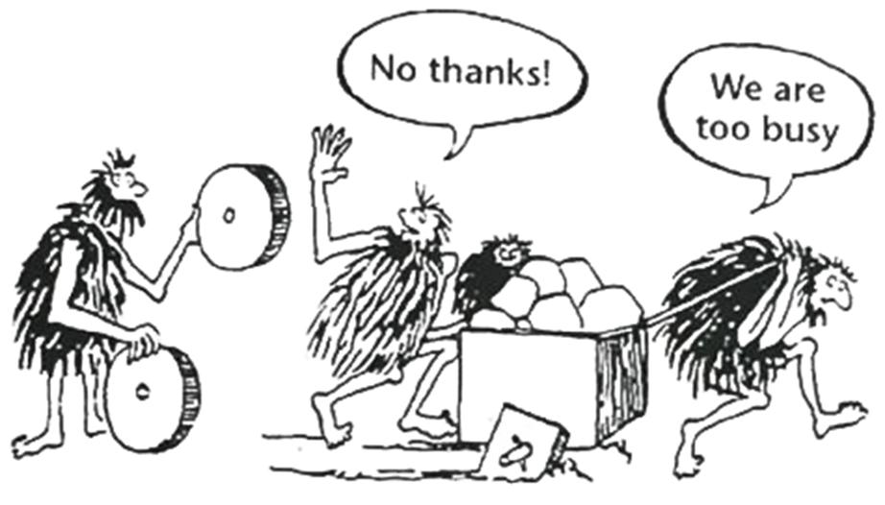
Ask for a Quick Tour
Look for ways to improve the business

Slide 64
Lean Principles
A Job Developer’s Toolkit

Slide 65

The Toyota Way
Principles are based on US supermarkets

Slide 66
Lean Key Principles
Focus is on the customer’s experience and continuous process improvement
Goal is to identify Value-Adding services and eliminate waste to create “on-demand service” and one-piece “flow”
  Remove Waste: Take out the rocks and the stream will run more swiftly
  To work smarter, not harder
Notes:
Lean seeks to improve the process– by eliminating things that get in the way of doing the important work.

Slide 67
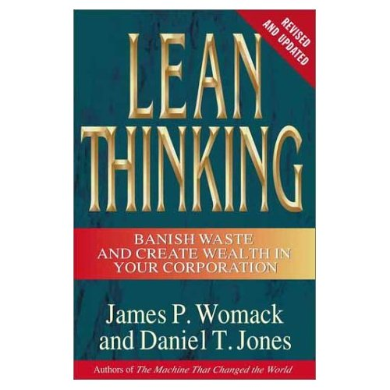
Lean Principles:
A Job Developer’s Toolkit
A process improvement approach that focuses on the customer and seeks to identify “WASTE” and inefficient processes
Learn to talk the language of business

Slide 68
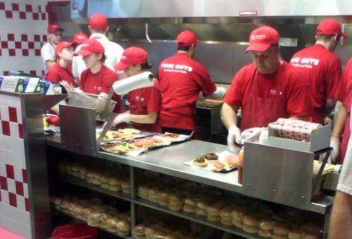

Lean in Action: Fast Food
Have it your way
Orders on Demand
Streamline processes

Slide 69
Identify ways to streamline processes and improve workflow
What is the product (or service)?
  Are there ways to make product faster or service better?
  Are there ways to make product cheaper or save money?
  Are there ways to increase the number of customers served or improve the customer experience?
  Are the customers (and staff) happy?
      Costs $.80 to keep a customer and $3.00 to
      make a new one
      Costs $5-$10k to hire and train a new employee

Slide 70
Identify Issues/Challenges
Customer /employee complaints
Log jams/backlogs/long lead times/Waiting
Unassigned, but critical tasks
Burn-out or high turnover
Managers or key staff pulled away from core tasks
Workflow fluctuations
  Rush times, crunch times, seasonal fluctuations, sporadic- but important tasks that are not getting done

Slide 71

Lean: 8 Types of Waste
Correction
Overproduction
Motion
Material movement/transport
Waiting
Inventory
Processing
Underutilization of people
Hand out: Examples of Waste for Job developers

Slide 72
During Informational Interviews: Look for “Waste”
Wasted Talent
  Identify who are the “surgeons” (aka highly paid or income-generating staff) Are they doing surgery?
  What are the set-up and button-up tasks for supporting the essential work?
Wasted Time
  Orders not processed because too busy taking new ones
  Machines/supplies not maintained- work stops
Wasted Resources
  Inventory- supplies never used or too much of what is needed
  Overproduction- 50 kits - we ordered 1,000.. expired, obsolete.
  Is the employer using temporary workers? Paying overtime?

Slide 73
Evaluate your Prospect
Is it the perfect setting for your candidate?
Can your candidate benefit this business?
Notes:
You are solving the employer’s staffing issues-not placing your applicant.

Slide 74

Is this a Good Prospect for your Candidate?
Can your candidate address a need and add value?
Is the environment right?
Does this situation “fit like a glove”?
Notes:
If they say no, what do we do?

Slide 75
Not a Prospect for this Candidate
Continue to build a relationship with this employer:
Thank him/her/them for time and expertise
Stay in contact (send resources or interesting articles)
Get the business engaged with your organization in small ways:
  Business Advisory Council
  Talk at Job Clubs
  Critique resumes
  Mock interviews
  Job Shadows

Slide 76
Negotiating with Employers
Presenting your ideas, solutions
and your candidate

Slide 77
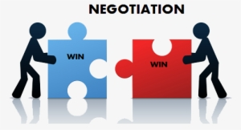
Negotiating a New Position
Present your ideas & solutions
Assist the employer to understand how customizing a job will benefit the business
Help organize the new position.

Slide 78

What do Employers Value?
Motivated employees who are excited about their work.
Candidates with skills sets that can add value to their workforce.
Business solutions that improve the company’s productivity and/or work processes.

Slide 79
Marketing Axiom: FAB
Features/Advantages/Benefits
Features describe the product, service or characteristic
Advantages explain what the user gains form the features
Benefits explain the outcomes of gains:

Slide 80
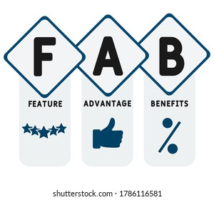
Features/Advantages/Benefits
Examples:
  Toothpaste with a stain-removing formula, that's a feature. The advantage, is whiter teeth, the benefit is More Dates.
  Anti-lock brakes are the features on a car, Advantage is car doesn’t skid on ice, benefit is consumer safety, Saves Lives.
Notes:
Features describe the product or service
Benefits explain what the user gains from the features

Slide 81

List the “features” and “benefits” of the chair you are sitting on. For every feature, create at least one benefit.
Now Let’s do the same for your services…
Features to Benefits

Slide 82
Features of
Our Employment Services
Trained, professional Employment Consultant
Applicant screening and training
Training and Consultation
Pool of Applicants
82
Notes:
82

Slide 83
Advantage of Using Our Services
Makes it easy to find pre-screened, qualified candidates
Support in onboarding, training and problem-solving with a new employee
Resources and expertise in accommodations and teaching strategies
Customizing a job can improve workflow and reduce waste
Providers fresh set of eyes, an “outsider perspective”
Diversifies the workforce
Provides productive, dependable, loyal employees
Employers can tailor positions to support busy teams or address fluctuations (seasonal needs or rush times)

Slide 84
Benefits for Employers
Creates a more Cost Effective way to work:
  Increases productivity: Core teams can focus on key aspects of their positions
  Lowers turn-over saves money and time (Hiring and training a new hire can cost an employer between $7-$10K)
  Supports busy departments during crunch times/busy seasons
“Diversity” sparks innovation and improves collaboration
Reduces recruitment and training costs for support positions
Leverages resources of employment service to assist with orientation and training of the new employee.
A Resource for managing “Disability” within your workforce to keep people on the job
Notes:
In these instances, the right to work is earned. Job seekers must demonstrate desired competencies and skills.

Slide 85
Job/Employment Proposals
Identify entry level job tasks & potential business needs
Research needs of local employers. Find out what positions have high turnover & what parts of jobs do not get done or get done effectively
Provide clear, concise, written proposals to employer
Stress cost effectiveness and benefits of restructuring and/or creating a new position
Don’t be afraid to ask! Be up front and clear with employers about what you want and what you can offer

Slide 86
Employer Proposal Template

Slide 87
Potential Tasks Lists
Gets the employer thinking--and talking about tasks (vs. job postings)
Speak the employer’s language
  Use employer’s jargon and organizational terms
List specific job tasks (doing what for whom?)
  not general statements like “file”, “photocopy”
List most important tasks (needs) first
  Which tasks will have the greatest impact?

Slide 88
Close the deal
Cost-Savings Analysis
Estimates cost savings by not using a highly trained staff person to do “set-up”/“button-up” tasks (routine, entry-level, support tasks)
Only included when customized job position will help get the work done in a less expensive way
Projects costs/savings over 5-year period to demonstrate additional savings due to Cost-of-Living Adjustments (COLA)

Slide 89
“Here’s the Perfect Candidate”
Use a professional looking resume, tailored to your negotiated tasks
Focus conversation on job seeker’s skills, not deficits
Turn the Jobseeker’s “features” into “benefits”
Your candidate is “a solution to an employer’s issue”. This is not about charity- or giving someone a chance

Slide 90
A Customized Process
Creating opportunities for Robert

Slide 91
A Customized Process
Creating opportunities for Rob

Slide 92

Meet Rob
What we discovered:
Good clerical/computer skills
Loves physical jobs, likes building things
Likes structured, consistent tasks
Hates to be interrupted
Brutally honest
Loves to SCIENCE and finding out how things work.
What his file said:
Autism
Impulsive, uncooperative and inflexible
Inappropriate behaviors, very poor social skills
Worked unsuccessfully in stocking positions
Basic math & reading skills
Notes:
HOW DID WE GET THERE?
Person-centered planning with a purpose
Focus on preferences and what a person can do
Shifts emphasis to adding value
Targets businesses where job seeker’s unique characteristics and skills will be assets
The Tornado
Roy working at a car wash where they do detailing for Pacific Heights residents – very high end cars. Chauffeurs would bring cars in. Roy works on the outside of the cars, but also gets to sit inside them while cleaning the inside.
When he interviewed, he hit it off right away with the owner – talking about luxury cars.
Divisidero Touchless Car Wash
So how do you come up with a job that hits the mark – motivates, right amount of activity, uses person’s strengths?

Slide 93
Rob’s VENN Diagram
What’s a good job for Rob?
Back of the house. No customer service
Science, tinkering, building things
Routine, Consistent tasks

Slide 94
Informational Interview:
A Visit to the Exploratorium
Shipment comes three times a week- we can’t get in the room for the two days after.
I have people with master’s degrees- bagging rocks.
The office is a mess. Look at all these catalogs we get.
The website orders were just given to my department. We don’t have anyone to process these orders.
Inventory is around the corner- I’m afraid to even open the door to the backstock area.

Slide 95
Employer Proposal

Slide 96
Potential Tasklist for Exploratorium
Notes:
Translates a candidate’s Features into Benefits
Are based on targeted employer’s needs and a specific job seeker’s skills
Demonstrates how a job seeker with more limited skill sets can be a valuable addition to an employer’s workforce

Slide 97
Exploratorium:
Cost-Savings Analysis
Estimates cost savings by not utilizing highly-trained staff to do basic, routine tasks
Projecting costs over 5-year period demonstrates additional savings due to Cost of Living Adjustments (COLA)

Slide 99
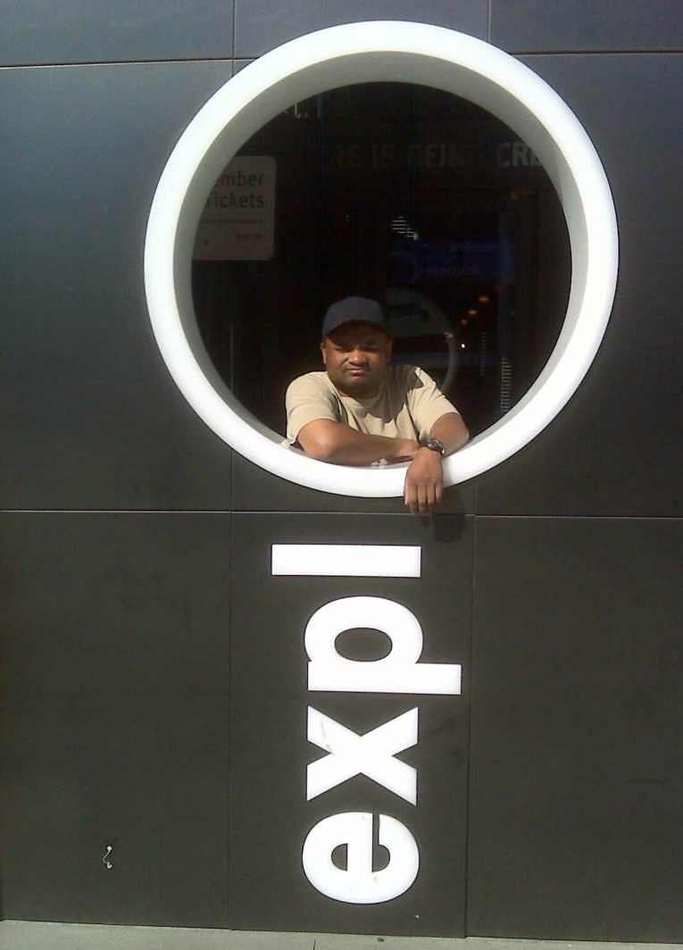
Robert
Merchandise Expediter, for the Exploratorium

Slide 100
“We’re not hiring” to
“When can he start?”
Rob has skills and attributes the employer valued
He is extremely interested in the business
  “He’s one of us”
  Minimizes disability
Job developer identified needs and presented a cost effective, solution to the employer’s problems
Job developer helped the employer to understand how to utilized Rob’s skills and accommodate his disabilities

Slide 101
Lessons Learned
CE reframes how we see our job seekers and how we partner with employers
CE is about “building opportunities” based on an Employer’s needs and Job Seeker’s strengths

Slide 102
For More Information:
Sara Murphy
785 Market Street, Suite 670
San Francisco, CA 94110 USA
415.979.9520 (office)
415.225.2187 (cell)
smurphy@transcen.org

Slide 103

About TransCen
TransCen, Inc. is a national organization offering web-based and in-person training for state agencies, school districts, provider organizations, and others interested in meaningful work and community inclusion for individuals with disabilities.
Learn more about our work: www.transcen.org
Contact us at inquiries@transcen.org for more information!

