Slide 1
Zero Tolerance Initiative overview

Slide 2
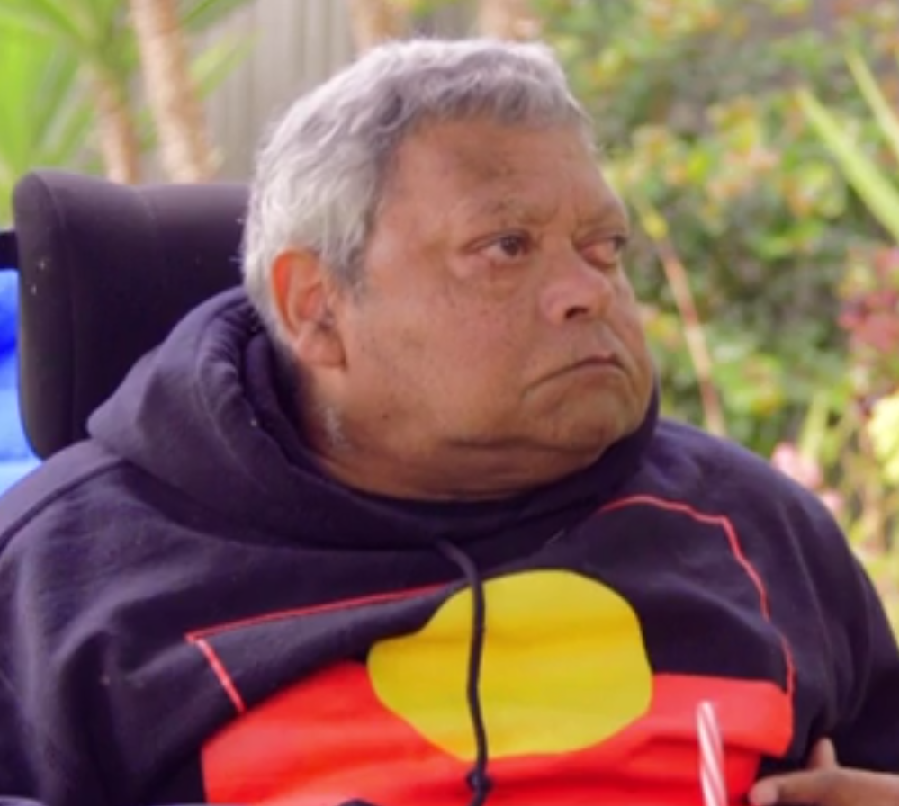
When we talk about abuse, neglect and violence…
Some of the things we talk about might make you feel uncomfortable
It’s OK to have a break if you need to
Think about who you can talk to if you need extra support
Beyond Blue: 1300 22 4636 www.beyondblue.org.au.
Lifeline 13 11 14 www.lifeline.org.au
1800 Respect 1800 737 732 www.1800respect.org.au

Slide 3
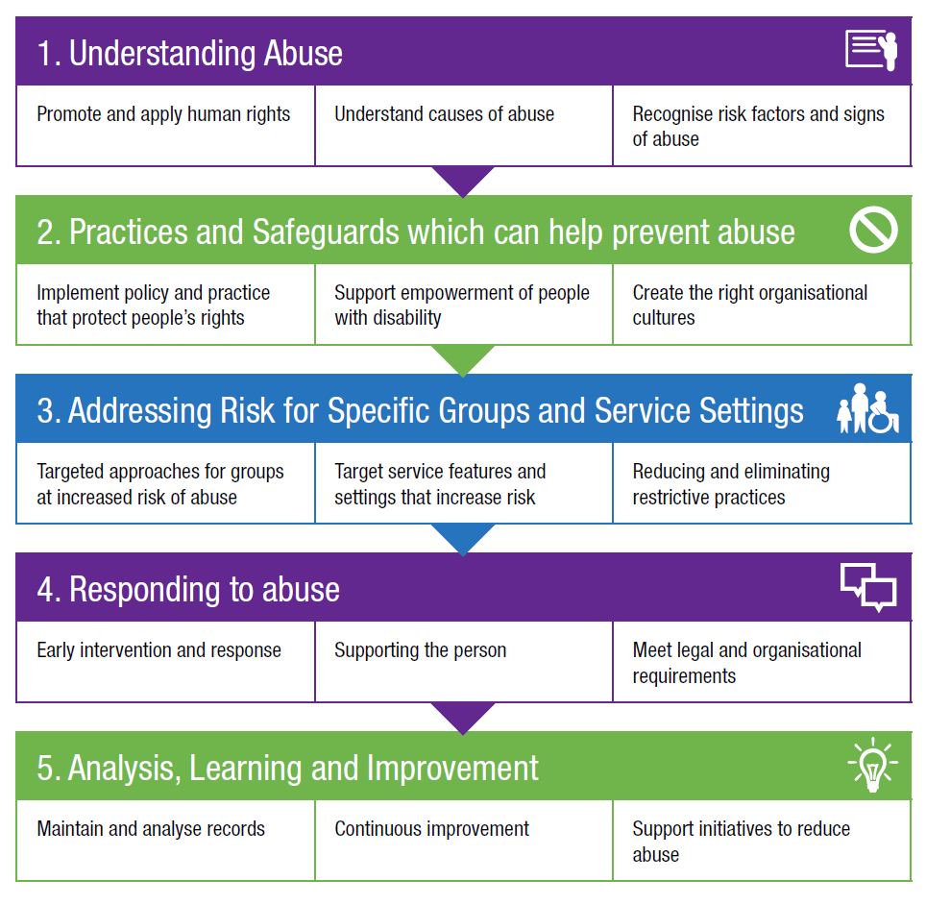
The Zero Tolerance framework

Slide 4
‘Speaking Up About Safety’
In the 2014 report ‘Speaking Up About Safety, people with disability said that they feel safe when service providers:
listen
respect people’s choices and decisions
involve people with disability in planning their services
make sure that staff can do their job properly
get to know people and treat them as an individual
support contact with services like police or advocacy
ensure respect for personal space and privacy
offer choice about who people live with
https://www.nds.org.au/images/resources/resource-files/speaking-up-about-safety-fullreport.pdf

Slide 5
Human Rights and You: 30 minute eLearning program and guide
Understanding Abuse: 40 minute eLearning program, set of eight films, workbook and guide for supervisors
Empowerment Circle
Practice advice: Safer Recruitment and Screening, Supervision and Safety
Positive Cultures: set of eight films and guide
Recognising Restrictive Practices: seven pairs of films and guide
Responding to Abuse: set of eight films and guide
Safeguarding for Boards guide

Slide 6
How to use the Zero Tolerance resources
In board meetings
As part of induction
During ongoing staff training
As part of supervision
During staff meetings or team discussions
In personal reflection
With people with disability, families and carers

Slide 7
Abuse and neglect can be:
Deliberate
Accidental
Systemic
staff don’t realise their actions are abuse
staff don’t understand the impact of their actions
actions indirectly impact on someone else.
perpetrators target people with disability
people seek to harm or take advantage of others
exploit vulnerability of systems and people
staff not trained or supervised properly
staff don’t have the resources to do their job
insufficient staff due to high sick leave / turnover
people forced to live with others who pose a risk.
prioritisation of routine over personal choice
cutting corners, rushing activities and supports.

Slide 8
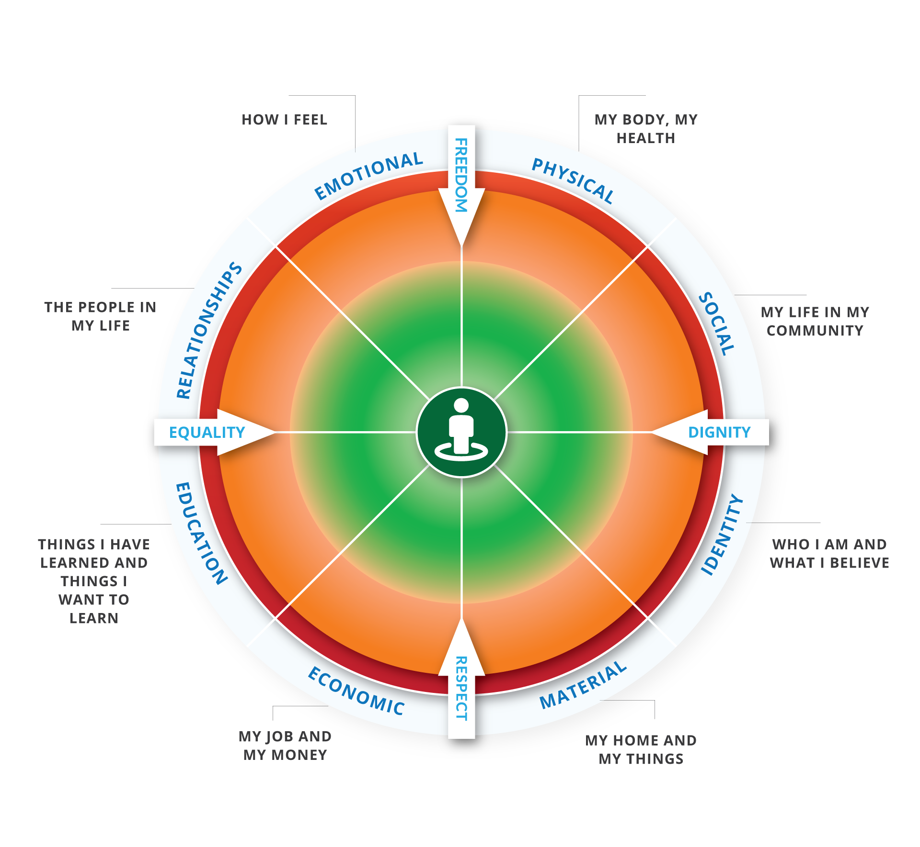
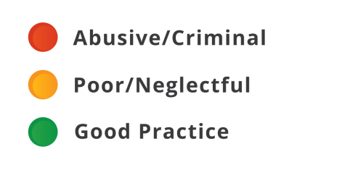
The Empowerment Circle

Slide 9
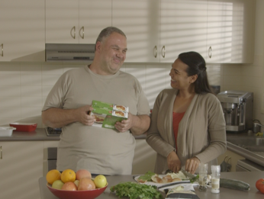
The Zero Tolerance Commitment
A commitment by organisations and people to speak up and take action on:
anything that does not support a person’s rights
anything that might make a person feel or be unsafe
anything they could be doing better

Slide 10
Contact us:
NDS Zero Tolerance website: https://www.nds.org.au/resources/zero-tolerance
Mary Lou McPherson: maryloumcpherson@nds.org.au
Dave Relf: dave.relf@nds.org.au

